Slide 1
Machine Learning
Linear Model Selection and Regularization

Slide 2
Contents
Subset Selection
stepwise selection
Adjusted R^{2 /} RSS
AIC (Akaike information criterion)
BIC (Bayesian information criterion)
C_{p} (equivalent to AIC for linear regression)
SSTO
Shrinkage / Regularization
Ridge regression
Lasso
Bias/ Variance Trade-off
Dimension Reduction
Principal Components Analysis (PCA)
Partial Least Squares

Slide 3
Improving on the Least Squares Regression Estimates?
We want to improve the Linear Regression model, by replacing the least square fitting with some alternative fitting procedure, i.e., the values that minimize the mean square error (MSE)
There are 2 reasons we might not prefer to just use the ordinary least squares (OLS) estimates
Prediction Accuracy
Model Interpretability

Slide 4
1. Prediction Accuracy
The least squares estimates have relatively low bias and low variance especially when the relationship between Y and X is linear and the number of observations n is way bigger than the number of predictors p
Note: High bias – underfitting ; High variance – overfitting. Bias-Variance tradeoff
But, when , then the least squares fit can have high variance and may result in over fitting and poor estimates on unseen observations,
And, when , then the variability of the least squares fit increases dramatically, and the variance of these estimates in infinite

Slide 5
2. Model Interpretability
When we have a large number of variables X in the model there will generally be many that have little or no effect on Y
Leaving these variables in the model makes it harder to see the “big picture”, i.e., the effect of the “important variables”
The model would be easier to interpret by removing (i.e. setting the coefficients to zero) the unimportant variables

Slide 6
Solution
Subset Selection
Identifying a subset of all p predictors X that we believe to be related to the response Y, and then fitting the model using this subset
E.g. best subset selection and stepwise selection
Shrinkage / Regularization
Involves shrinking the estimates coefficients towards zero by adding a penalty
This shrinkage reduces the variance and hence overfitting
Some of the coefficients may shrink to exactly zero, and hence shrinkage methods can also perform variable selection
E.g. Ridge regression and the Lasso
Dimension Reduction
Involves projecting all p predictors into an M-dimensional space where M < p, and then fitting linear regression model
E.g. Principle Components Regression

Slide 7
Best Subset Selection
In this approach, we run a linear regression for each possible combination of the X predictors
How do we judge which subset is the “best”?
One simple approach is to take the subset with the smallest RSS or the largest R²
Unfortunately, one can show that the model that includes all the variables will always have the largest R² (and smallest RSS)

Slide 8
Credit Data: R² vs. Subset Size
The RSS/R² will always decline/increase as the number of variables increase so they are not very useful
The red line tracks the best model for a given number of predictors, according to RSS and R²

Slide 9
Other Measures of Comparison
To compare different models, we can use other approaches:
Adjusted R²
AIC (Akaike information criterion)
BIC (Bayesian information criterion)
C_{p} (equivalent to AIC for linear regression)
These methods add penalty to RSS for the number of variables (i.e. complexity) in the model
None are perfect

Slide 10
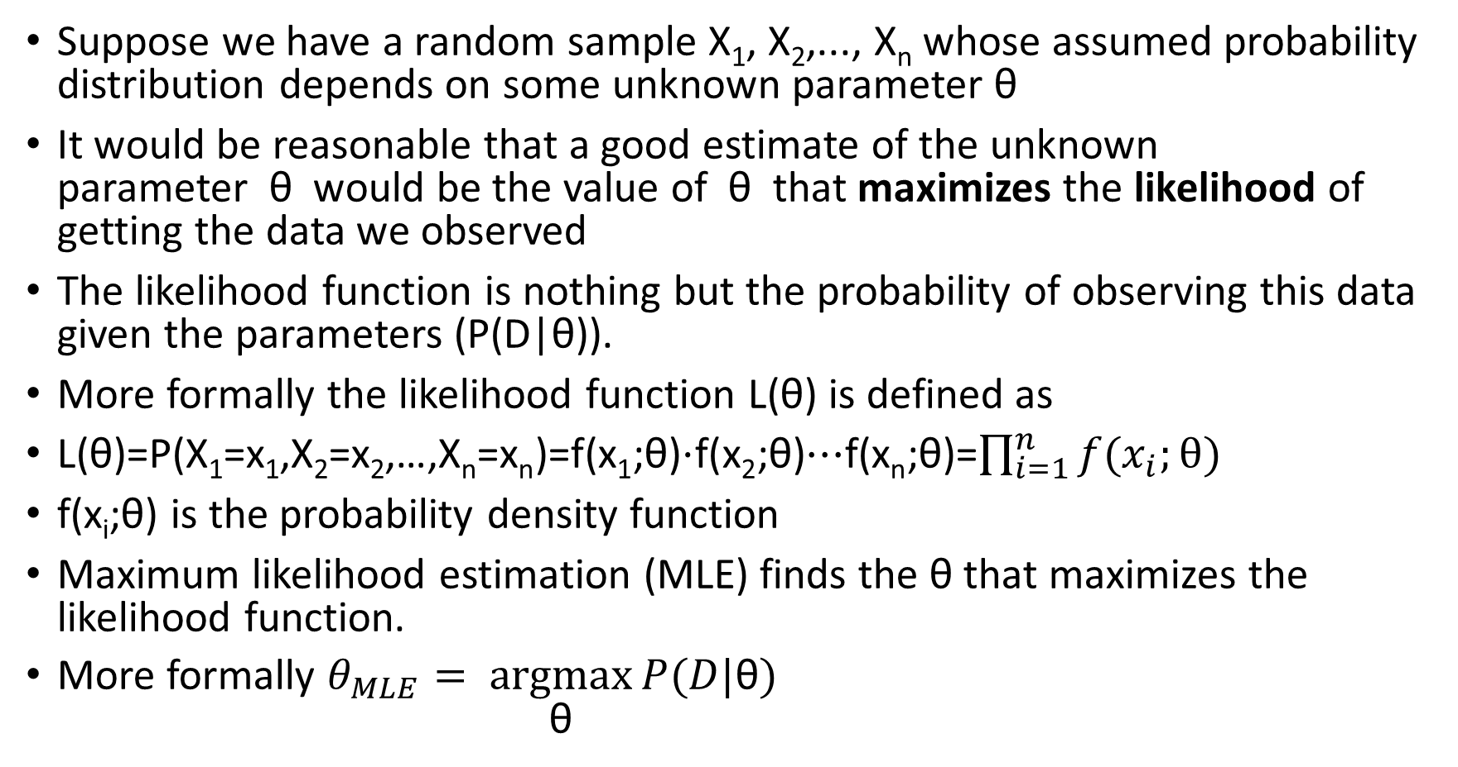
Likelihood function
Suppose we have a random sample X₁, X₂,..., X_{n} whose assumed probability distribution depends on some unknown parameter θ
It would be reasonable that a good estimate of the unknown parameter θ would be the value of θ that maximizes the likelihood of getting the data we observed
The likelihood function is nothing but the probability of observing this data given the parameters (P(D|θ)).
More formally the likelihood function L(θ) is defined as
L(θ)=P(X₁=x₁,X₂=x₂,…,X_{n}=x_{n})=f(x₁;θ)⋅f(x₂;θ)⋯f(x_{n};θ)=$\prod_{i=1}^{n}{f(x_{i};}θ)$
f(x_{i};θ) is the probability density function
Maximum likelihood estimation (MLE) finds the θ that maximizes the likelihood function.
More formally $θ_{MLE}= \underset{\text{θ}}{argmax}{P(D|\text{θ})}$

Slide 11
Measures of Comparison
AIC (Akaike information criterion)
AIC = −2logL(θ)+2p
where p is the number of parameters.
Faced with a collection of models, the 'best' (or 'least bad') one can be chosen by seeing which has the lowest AIC.
Bayes Information Criterion (BIC)
BIC = −2logL(θ)+plog(n)
n is the sample size
Lowest BIC is taken to identify the 'best model'
BIC tends to favor simpler models than those chosen by AIC.

Slide 12



Measures of Comparison
Mallows’ C_{p} Criterion
C_{p} considers ratio of SSE for p – 1 variable model to MSE for full model; then penalizes for the number of variables:
A model is considered “good” if C_{p} ≤ p
MSE is mean square error. SSE is sum of squared errors
Adjusted R²
Penalizes the R² value based on the number of variables in the model:
SSTO is total sum of squares

Slide 13
Credit Data: C_{p}, BIC, and Adjusted R²
A small value of C_{p} and BIC indicates a low error, and thus a better model
A large value for the Adjusted R² indicates a better model

Slide 14
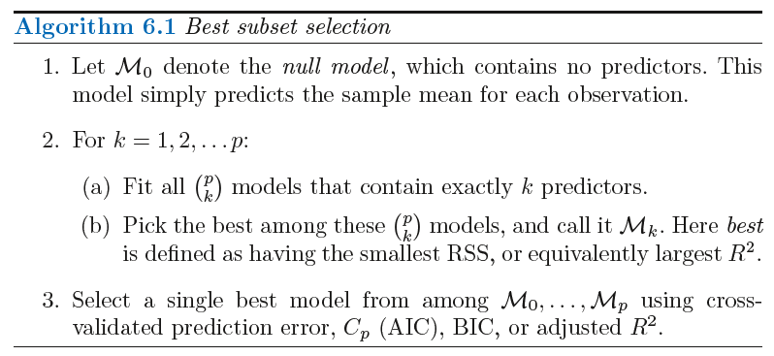
Best Subset Selection
Expensive - Fits 2^{p} models

Slide 15
Stepwise Selection
Best Subset Selection is computationally intensive especially when we have a large number of predictors (large p)
More attractive methods:
Forward Stepwise Selection: Begins with the model containing no predictor, and then adds one predictor at a time that improves the model the most until no further improvement is possible
Backward Stepwise Selection: Begins with the model containing all predictors, and then deleting one predictor at a time that improves the model the most until no further improvement is possible
A hybrid version that incorporates ideas from both main types: alternates backwards and forwards steps, and stops when all variables have either been retained for inclusion or removed

Slide 16
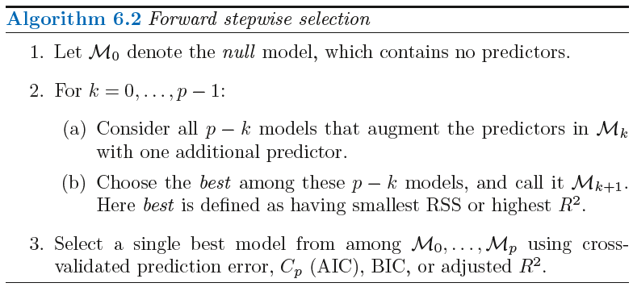
Forward Stepwise Selection
Fits - 1+p(p+1)/2 models

Slide 17
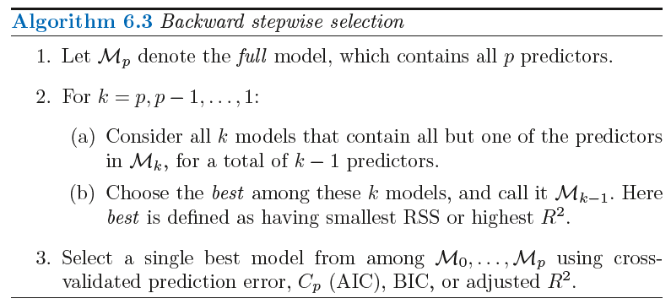
Backward Stepwise Selection
Fits - 1+p(p+1)/2 models
Backward selection requires that the number of samples n is larger than the number of variables p (so that the full model can be fit). In contrast, forward stepwise can be used even when n < p, and so is the only viable subset method when p is very large

Slide 18
Ridge Regression (also called L1 regularization)
Shrinkage Methods
The subset selection methods involve using least squares to fit a linear model that contains a subset of the predictors.
As an alternative, we can fit a model containing all p predictors using a technique that constrains or regularizes the coefficient estimates, or equivalently, that shrinks the coefficient estimates towards zero.
Ordinary Least Squares (OLS) estimates by minimizing
Ridge Regression uses a slightly different equation
Shrinkage Penalty
λ ≥ 0 is a tuning parameter

Slide 19
Ridge Regression Adds a Penalty on
The effect of this equation is to add a penalty of the form
Where the tuning parameter is a positive value.
This has the effect of “shrinking” large values of towards zero.
It turns out that such a constraint should improve the fit, because shrinking the coefficients can significantly reduce their variance
Notice that when = 0, we get the OLS!

Slide 20
Credit Data: Ridge Regression
As increases, the standardized coefficients shrinks towards zero.

Slide 21
Why can shrinking towards zero be a good thing to do?
It turns out that the OLS estimates generally have low bias but can be highly variable. In particular when n and p are of similar size or when n < p, then the OLS estimates will be extremely variable
The penalty term makes the ridge regression estimates biased but can also substantially reduce variance
Thus, there is a bias/ variance trade-off

Slide 22
Ridge Regression Bias/ Variance
Black: Bias
Green: Variance
Purple: MSE
Increase increases bias but decreases variance

Slide 23
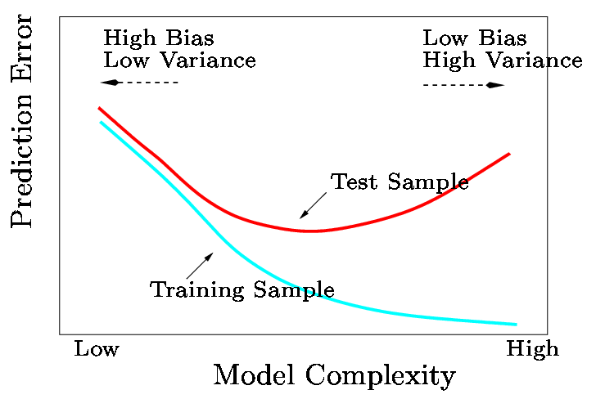
Bias/ Variance Trade-off
In general, the ridge regression estimates will be more biased than the OLS ones but have lower variance
Ridge regression will work best in situations where the OLS estimates have high variance

Slide 24
Computational Advantages of Ridge Regression
If p is large, then using the best subset selection approach requires searching through enormous numbers of possible models
With Ridge Regression, for any given , we only need to fit one model and the computations turn out to be very simple
Ridge Regression can even be used when p > n, a situation where OLS fails completely!

Slide 25
The LASSO (Least Absolute Shrinkage and Selection Operator)
Ridge Regression isn’t perfect
One significant problem is that the penalty term will never force any of the coefficients to be exactly zero. Thus, the final model will include all variables, which makes it harder to interpret
A more modern alternative is the LASSO
The LASSO works in a similar way to Ridge Regression, except it uses a different penalty term
LASSO also called L1 regularization

Slide 26
LASSO’s Penalty Term
Ridge Regression minimizes
The LASSO estimates the by minimizing the

Slide 27
What’s the Big Deal?
This seems like a very similar idea but there is a big difference
Using this penalty, it could be proven mathematically that some coefficients end up being set to exactly zero
With LASSO, we can produce a model that has high predictive power and it is simple to interpret

Slide 28
Credit Data: LASSO

Slide 29
6.2.3 Selecting the Tuning Parameter
We need to decide on a value for
Select a grid of potential values, use cross validation to estimate the error rate on test data (for each value of ) and select the value that gives the least error rate

Slide 30


Dimension Reduction Methods
We now explore a class of approaches that transform the predictors and then fit a least squares model using the transformed variables. We will refer to these techniques as dimension reduction methods.
Let Z₁;Z₂;….. ;Z_{M} represent M < p linear combinations of our original p predictors. That is
for some constants φ_{m1}; ….. ; φ_{mp}
We can then fit the linear regression model
using least squares
Dimension reduction serves to constrain the estimated coefficients
Can win in the bias-variance tradeoff

Slide 31
Principal Components Regression
Here we apply principal components analysis (PCA) to define the linear combinations of the predictors, for use in our regression.
The first principal component is that (normalized) linear combination of the variables with the largest variance.
The second principal component has largest variance, subject to being uncorrelated with the first.
And so on.
Hence with many correlated original variables, we replace them with a small set of principal components that capture their joint variation.

Slide 32
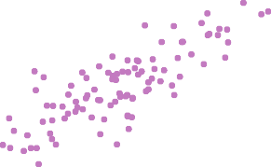
Pictures of PCA
Ad Spending
0 5 10 15 20 25 30 35
10
20
30 40 50
60
70
Population
The population size (pop) and ad spending (ad) for 100 different cities are shown as purple circles. The green solid line indicates the first principal component, and the blue dashed line indicates the second principal component.

Slide 33
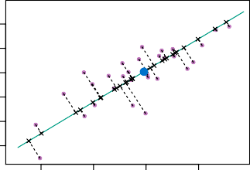
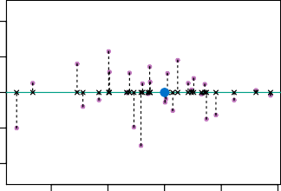
Pictures of PCA: continued
30
2nd Principal Component
5 10
Ad Spending
25
20
−10 −5 0
15
10
5
20
30 40
Population
50
−20
−10 0 10
1st Principal Component
20
A subset of the advertising data. Left: The first principal component, chosen to minimize the sum of the squared perpendicular distances to each point, is shown in green. These distances are represented using the black dashed line segments. Right: The left-hand panel has been rotated so that the first principal component lies on the x-axis.

Slide 34
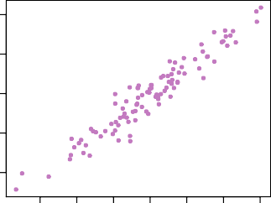
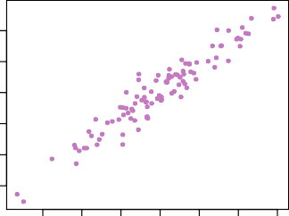
Pictures of PCA: continued
60
30
50
Ad Spending
10 15 20 25
Population
40
30
20
5
−3 −2 −1 0 1
1st Principal Component
2
3
−3 −2 −1 0 1
1st Principal Component
2
3
Plots of the first principal component scores z_{i1} versus pop and ad. The relationships are strong.

Slide 35
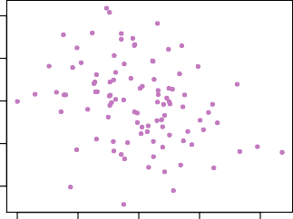
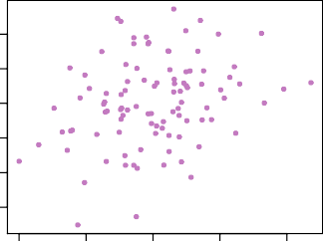
Pictures of PCA: continued
60
30
50
Ad Spending
10 15 20 25
Population
40
30
20
5
−1.0
−0.5 0.0 0.5 1.0
2nd Principal Component
−1.0
−0.5 0.0 0.5 1.0
2nd Principal Component
Plots of the second principal component scores z_{i2} versus pop and ad. The relationships are weak.

Slide 36
Application to Principal Components Regression
70
150
Squared Bias Test MSE Variance
Mean Squared Error
60
Mean Squared Error
50
100
40
30
20
50
10
0
0
0
10 20 30
Number of Components
40
0
10 20 30
Number of Components
40
PCR was applied to two simulated data sets. The black, green, and purple lines correspond to squared bias, variance, and test mean squared error, respectively.

Slide 37
Choosing the number of directions M
400
Income
Limit
Rating
Student
20000 40000 60000 80000
Standardized Coefficients
300
Cross−Validation MSE
200
100
0
−100
−300
2 4
6
8 10
2 4 6 8
Number of Components
10
Number of Components
Left: PCR standardized coefficient estimates on the Credit data set for different values of M . Right: The 10-fold cross validation MSE obtained using PCR, as a function of M .

Slide 38
Partial Least Squares
PCR identifies linear combinations, or directions, that best represent the predictors X₁, . . . , X_{p}.
These directions are identified in an unsupervised way, since the response Y is not used to help determine the principal component directions.
That is, the response does not supervise the identification of the principal components.
Consequently, PCR suffers from a potentially serious drawback: there is no guarantee that the directions that best explain the predictors will also be the best directions to use for predicting the response.

Slide 39
Partial Least Squares: continued
Like PCR, PLS is a dimension reduction method, which first identifies a new set of features Z₁, . . . , Z_{M} that are linear combinations of the original features, and then fits a linear model via OLS using these M new features.
But unlike PCR, PLS identifies these new features in a supervised way – that is, it makes use of the response Y in order to identify new features that not only approximate the old features well, but also that are related to the response.
Roughly speaking, the PLS approach attempts to find directions that help explain both the response and the predictors.

Slide 40

Details of Partial Least Squares
After standardizing the p predictors, PLS computes the first direction Z₁ by setting each φ_{1j} in equal to the coefficient from the simple linear regression of Y onto X_{j} .
One can show that this coefficient is proportional to the correlation between Y and X_{j}
Hence, in computing
PLS places the
highest weight on the variables that are most strongly related to the response.
Subsequent directions are found by taking residuals and then repeating the above prescription.

Slide 41
Practice / HW
Load the cpus dataset from the MASS package
Use syct, mmin , mmax , cach , chmin, chmax as the predictors (independent variables) to predict performance (perf)
Perform best subset selection in order to choose the best predictors from the above predictors
What is the best model obtained according to Cp, BIC, and adjusted R²?
Show some plots to provide evidence for your answer, and report the coefficients of the best model obtained for each criteria.
Repeat using forward stepwise selection and also using backwards stepwise selection. How does your answer compare to the best subset results?

Slide 42
Practice / HW
Predict the number of applications received using the other variables in the College data set in library ISLR
(a) Split the data set into a training set and a test set using caret library and fit each of the following models using caret and ten fold cross validation.
(b) Fit a linear model using ordinary least squares on the training set, and report the test mean squared error obtained.
(c) Fit a ridge regression model on the training set, with λ chosen by cross-validation. Report the test mean squared error obtained. Report the value of λ used in the model
(d) Fit a lasso model on the training set, with fraction chosen by cross validation. Report the test mean squared error obtained, along with the number of non-zero coefficient estimates and the fraction.
(e) Fit a PCR model on the training set, with no. of principal components M chosen by cross-validation. Report the test mean squared error obtained, along with the value of M selected by cross-validation.
(f) Fit a PLS model on the training set, with M chosen by cross validation. Report the test error obtained, along with the value of M selected by cross-validation.
(g) Comment on the results obtained. Is there much difference among the test errors resulting from these five approaches?

Slide 43
Reading
Chapter 6 in An Introduction to Statistical Learning by Gareth James et al. PDF on Blackboard.

